Slide 1
Welcome to the world of Shell Scripting
Subhasis Samantaray

Slide 2
SHELL SCRIPTING
Why Shell scripting ?
History of Shells
Shell Features
Bang line or interpreter line
Comment lines
Command separator [semicolon]
Terminator in a case option
keywords
read ,echo,readonly
How to execute the script ?
Be careful of spacing !!!
Shell Variables
Flow control - if
Arithmetic Comparison
String Comparison
File test operator
Time comparision
Flow control - case
Special Shell variables
Positinal Parameter and use of shift
set and unset
while loop
until loop
for loop
select loop
function
getopts & optargs
wait & sleep
trap
return
eval
File descriptors
Timing the data entry
DB connectivity scripts.
Debugging
Quoting Variables
Use $RANDOM - To generate random integer
Double Parentheses Construct

Slide 3
Why Shell scripting ?
writing a shell script is much quicker than writing the equivalent code in other programming languages.
A shell script can be used to provide a sequencing and decision-making linkage around existing programs
Interactive debugging.
Interpretive running makes it easy to write debugging code into a script and rerun it to detect and fix bugs
To automate the manual job /task
To perform the sequece of steps which is repetative
To set up the environment prior to start/stop/deploy the application
To write batch jobs
Most of the scripts are completely portable across the whole UNIX world as long as they have been written to a common standard.

Slide 4
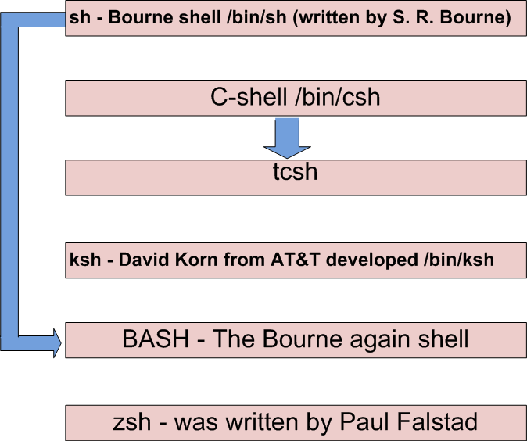
History of Shells

Slide 5

Shell features

Slide 6
Bang line or interpreter line
The sha-bang ( #!) at the head of a script tells your system that this file is a set of commands to be fed to the command interpreter indicated.
The #! is actually a two-byte magic number, a special marker that designates a file type, or in this case an executable shell script
Immediately following the sha-bang is a path name. This is the path to the program that interprets the commands in the script, whether it be a shell, a programming language, or a utility.
This command interpreter then executes the commands in the script, starting at the top (the line following the sha-bang line), and ignoring comments.
Example :
#!/bin/sh
#!/bin/ksh
#!/bin/bash
#!/usr/bin/perl
#!/usr/bin/tcl
#!/bin/sed -f
#!/usr/awk –f
A simple shell script :
#!/bin/ksh
echo “Welcome to the word of scripting”

Slide 7
Comment lines
Comments. Lines beginning with a # (with the exception of #!) are comments and will not be executed.
# This line is a comment.
Comments may also occur following the end of a command.
echo "A comment will follow." # Comment here.
# ^ Note whitespace before #
Comments may also follow whitespace at the beginning of a line.
# A tab precedes this comment.
Comments may even be embedded within a pipe.
initial=( `cat "$startfile" | sed -e '/#/d' | tr -d '\n' |\
# Delete lines containing '#' comment character.
sed -e 's/\./\. /g' -e 's/_/_ /g'` )
echo "The # here does not begin a comment."
echo 'The # here does not begin a comment.'
echo The \# here does not begin a comment.
echo The # here begins a comment.

Slide 8
Command separator [semicolon]
Command separator [semicolon]. Permits putting two or more commands on the same line.
echo hello; echo there
if [ -x "$filename" ]; then # Note the space after the semicolon.
echo "File $filename exists."; cp $filename $filename.bak
else
echo "File $filename not found."; touch $filename
fi; echo "File test complete."

Slide 9
Terminator in a case option [double semicolon].
case "$variable" in
ch1) echo "\$variable = ch1" ;;
ch2) echo "\$variable = ch2" ;;
esac

Slide 10
Remember the keywords ☺
read
echo
readonly
set
unset
shift
export
if
then
else
fi
elif
case
esac
break
continue
while
until
for
select
do
done
eval
trap
test
exec
sleep
wait
return
exit

Slide 11
Simple use of read ,echo,readonly
#!/bin/ksh
echo “Enter your name”
read name
echo “Welcome $name”
name=“Anil”
echo “Welcome $name”
#!/bin/ksh
echo “Enter your name”
read name
echo “Welcome $name”
## Error will be generated
## stating : name: is read only
readonly name
## we cant modify the values
## of readonly variables
name=“Anil”
echo “Welcome $name”

Slide 12
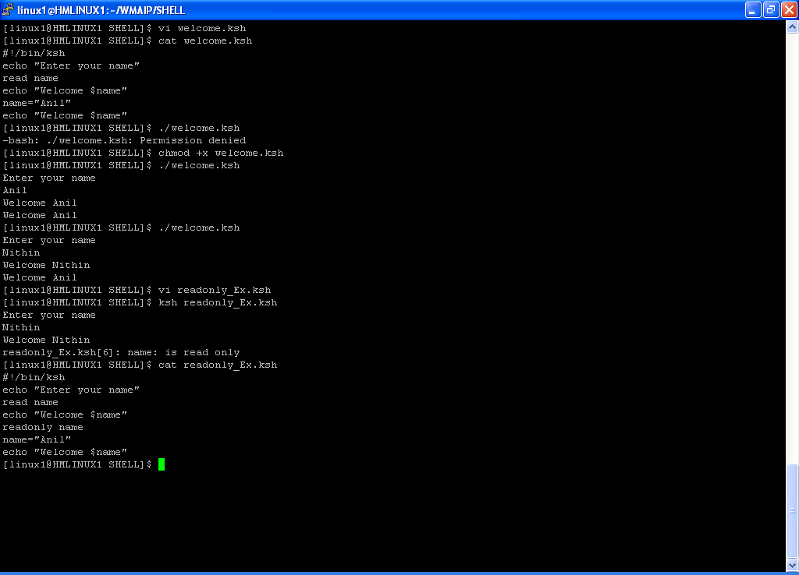
Example : read ,echo,readonly

Slide 13
Execute the script
We can execute the script in different ways
1)<SHELLNAME> <SCRIPT | SCRIPTNAME with Path>
Exacmple :
ksh Welcome.ksh
ksh /opt/proj/app/scripts/Welcome.ksh
2) chmod +x scriptname ; ./scriptname
Exacmple : [ Assume . is not present in path variable ]
chmod +x Welcome.ksh ;./ Welcome.ksh
3) chmod +x scriptname ; scriptname
Exacmple : [ Assume . is present in path variable ]
chmod +x Welcome.ksh ;Welcome.ksh
4) . <PATH OF SCRIPT>
Exacmple : [ This is used to set the environment or to execute the script in the same shell ]
. /opt/project/app/scripts/Setenv.ksh
. Setenv.ksh
. ./Setenv.ksh

Slide 14
Be careful of spacing
currdir=`pwd` | RIGHT SYNTAX
currdir = `pwd` | WRONG SYNTAX
if test "$currdir" = "/home/john"; then | RIGHT SYNTAX
if test "$currdir"="/home/john"; then | WRONG SYNTAX
YEAR=2010 | RIGHT SYNTAX
YEAR = 2010 | WRONG SYNTAX
YEAR =2010 | WRONG SYNTAX
DATE=“01 MAY 2010” | RIGHT SYNTAX
DATE=01 MAY 2010 | WRONG SYNTAX

Slide 15
Shell Variables
Variable names consist of alphabetic characters, numbers and underscores
([a-zA-Z0-9_], and cannot start with a number, and are case sensitive.
New variables can be instantiated like this
Variable=value
No spaces on either side of the equals sign
Variables are referenced like this:
$Variable
Example:
#!/bin/ksh
Var1=Hello
Var2=“Welcome to the world of Scripting”
echo $Var1 $Var2
#!/bin/sh
Var1="one"
Var2="$var1 two"
var3="$var2 three"
echo $var3

Slide 16
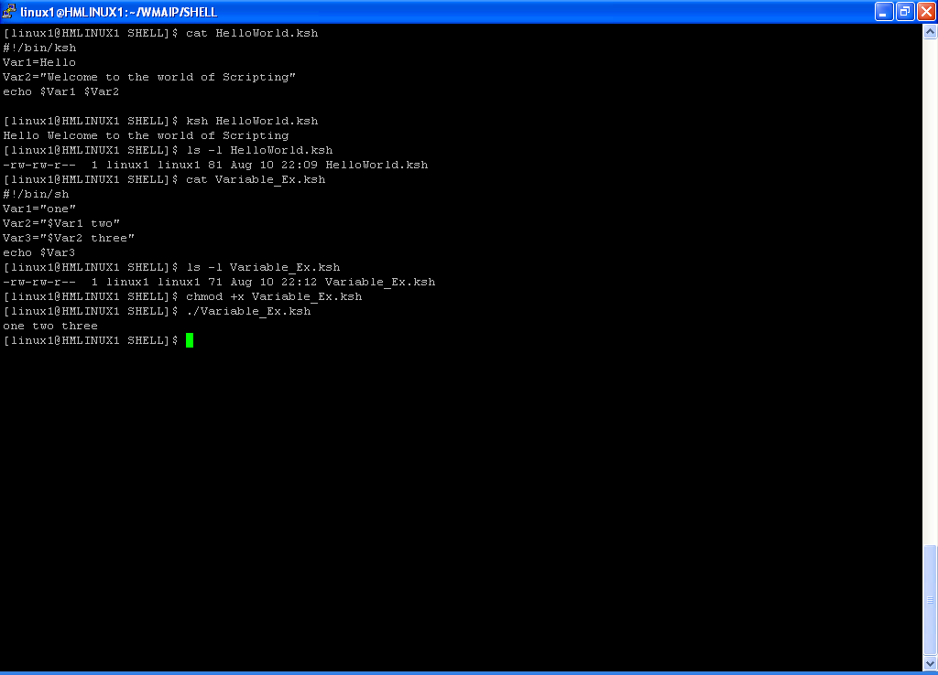
Example : Shell Variables

Slide 17
Flow control - if
if [ condition ]
then
Statements ….
fi
if [ condition ]
then
Statements ….
else
Statements ….
fi
if command
then
Statements ….
else
Statements ….
fi
if test ……
then
Statements ….
else
Statements ….
fi
if [ condition ]
then
Statements ….
else
if [ condition ]
then
Statements ….
else
Statements ….
fi
fi
if [ condition ]
then
Statements ….
elif [ condition ]
then
Statements ….
else
Statements ….
fi

Slide 18
Arithmetic Comparison
−eq | Equal to
−ne | Not equal to
−lt | Less than
−le | Less than or equal to
−gt | Greater than
−ge | Greater than or equal to

Slide 19
String Comparison
= | Equal to
== | Equal to
!= | Not equal to
\< | Less than (ASCII) *
\> | Greater than (ASCII) *
−z | String is empty
−n | String is not empty

Slide 20
File test operator
−e | File exists
−f | File is a regular file
−d | File is a directory
−h | File is a symbolic link
−L | File is a symbolic link
−b | File is a block device
−c | File is a character device
−p | File is a pipe
−g | sgid flag set
−u | suid flag set
−k | "sticky bit" set
−S | File is a socket
−t | File is associated with a terminal
−N | File modified since it was last read
−O | You own the file
−G | Group id of file same as yours
! | "NOT" (reverses sense of above tests)
−s | File is not zero size
−r | File has read permission
−w | File has write permission
−x | File has execute permission
F1 −nt F2 | File F1 is newer than F2 *
F1 −ot F2 | File F1 is older than F2 *
F1 −ef F2 | Files F1 and F2 are hard links to the same file *

Slide 21
Compound comparisons
-a
logical and
exp1 -a exp2 returns true if both exp1 and exp2 are true.
-o
logical or
exp1 -o exp2 returns true if either exp1 or exp2 are true.
These are similar to the Bash comparison operators && and ||, used within double brackets [[ ]].
if [[ condition1 && condition2 ]]
if [[ condition1 || condition2 ]]

Slide 22
if : Example
#!/bin/ksh
echo “Enter a number”
read num
if [ $num –ge 5 ]
then
echo “ $num greater than or equal to 5 “
fi
echo “Enter another number”
read num1
if [[ $num1 –le 5 ]]
then
echo “ $num1 lesss than or equal to 5 “
fi
#!/bin/ksh
echo “Enter a number”
read num
if [ $num –ge 5 ]
then
echo “ $num greater than or equal to 5 “
else
echo “ $num less than 5“
fi
echo “Enter another number”
read num1
if [[ $num1 –le 5 ]]
then
echo “ $num1 lesss than or equal to 5 “
else
echo “ $num1 greater than 5“
fi

Slide 23
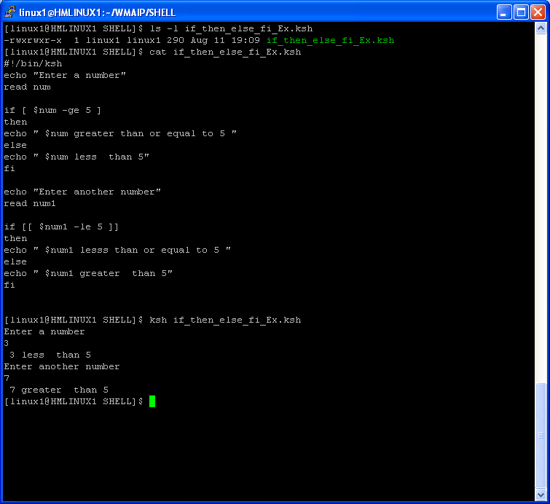
if : Example

Slide 24
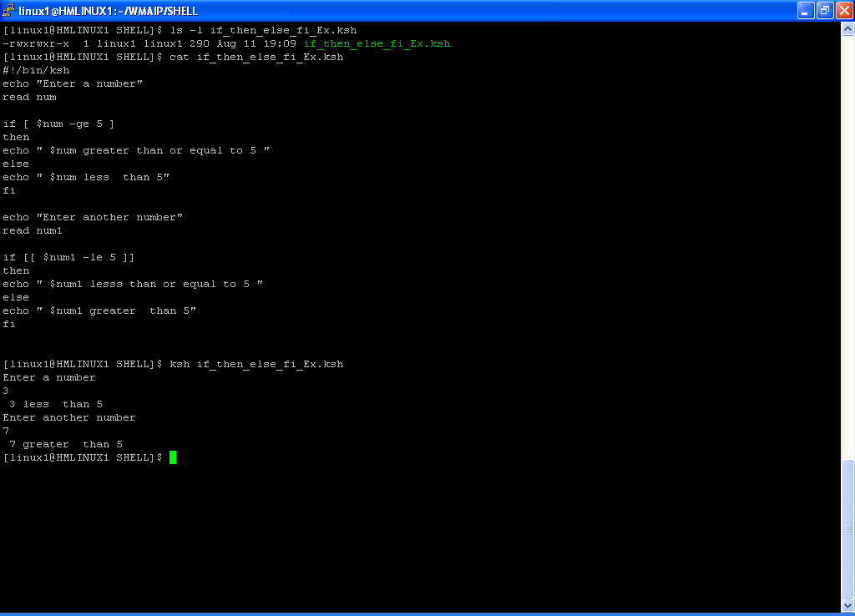
if : Example

Slide 25
if : Example
#!/bin/ksh
if grep -li "Qwest" ./* >/dev/null
then
echo "Qwest is present in the following files"
grep -li "Qwest" ./*
else
echo "Qwest is not present in any of the files"
fi
#!/bin/ksh
if test -f Qwest.txt
then
echo "Qwest.txt : File found "
else
echo " Qwest.txt : File not found "
fi
#!/bin/ksh
if ls Qwest.txt >/dev/null 2>&1
then
echo “Qwest.txt : file found"
else
echo " Qwest.txt : file not found"
fi
#!/bin/ksh
echo “Enter a number”
read num
if test $num –gt 3
then
echo “$num is greter than 3"
else
echo " $num is less than 3"
fi

Slide 26
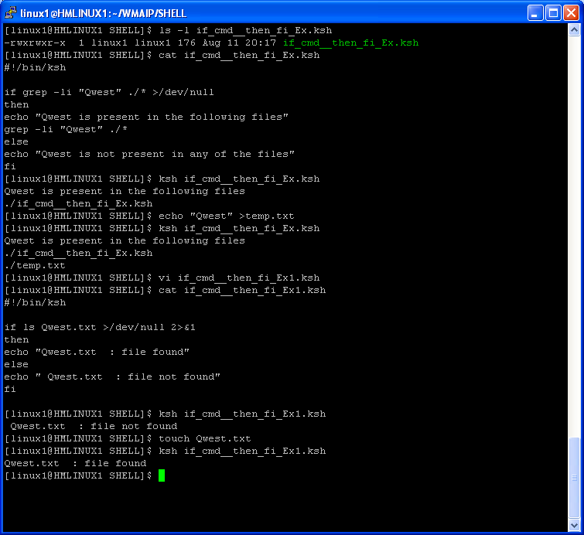
if : Example

Slide 27
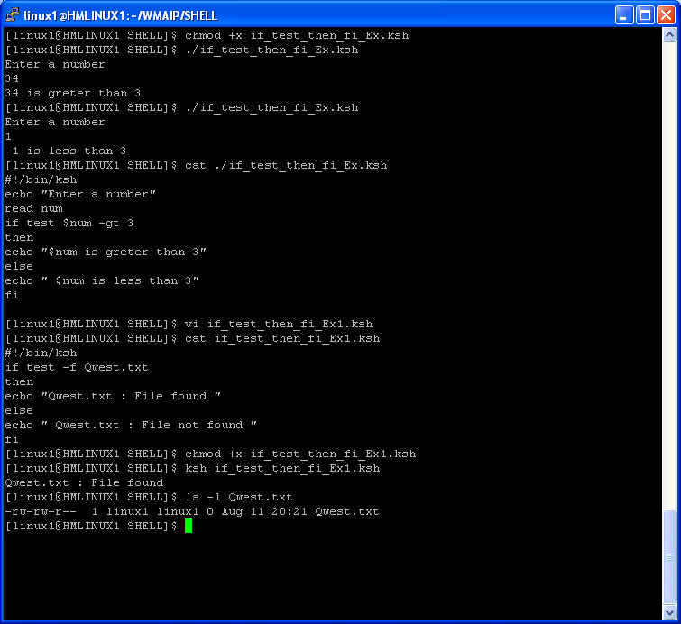
if : Example

Slide 28
if else if : Example
#!/bin/ksh
VALIDP="Qwest123" #Password
echo "Please enter the password:"
read PASSWORD
if [ "$PASSWORD" == "$VALIDP" ]
then
echo "ACCESS GRANTED"
else
echo "ACCESS DENIED!!!!"
fi
#!/bin/ksh
CURRENT_TIME=`date +"%T"`
echo " Current time : $CURRENT_TIME "
if [ $CURRENT_TIME > 12:00:00 ]
then
echo "TIME is greater than 12:00:00"
else
echo "TIME is less than 12:00:00"
fi
[[ $CURRENT_TIME < 23:00:00 ]] && echo "TIME is less than 23:00:00"
#!/bin/ksh
echo "1 - Start the App"
echo "2 - Shutdown the App"
echo "3 - Bounce the App"
echo "0 - Exit"
echo "Enter the choice [0-3]"
read choice
if [ $choice -eq 1 ]
then
echo "Selected Option -- 1"
else
if [ "$choice" = "2" ]
then
echo "Selected Option -- 2"
else
if [[ $choice -eq 3 ]]
then
echo "Selected Option -- 3"
else
if [ $choice -eq 0 ]
then
echo "Exit -- Selcted choice 0 "
else
echo "Invalid Choice"
fi
fi
fi
fi

Slide 29
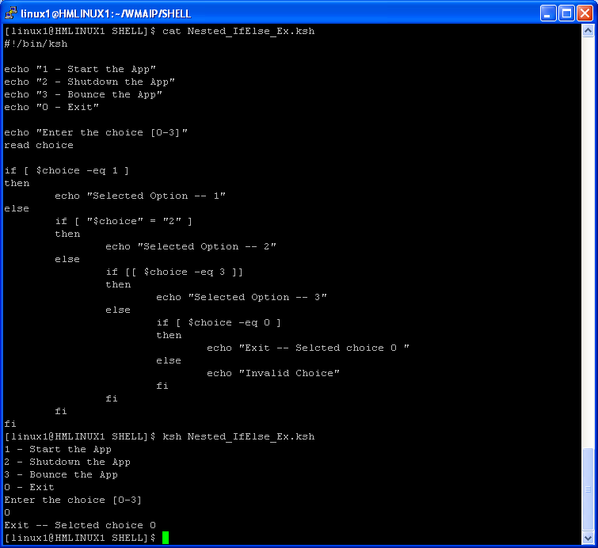
if else if : Example

Slide 30
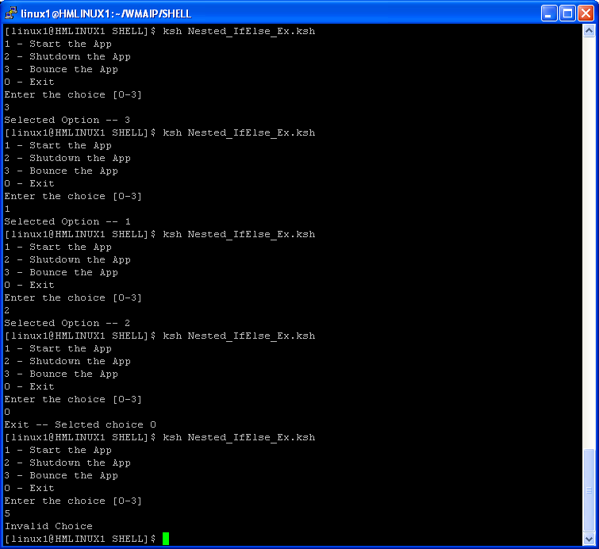
if : Example

Slide 31
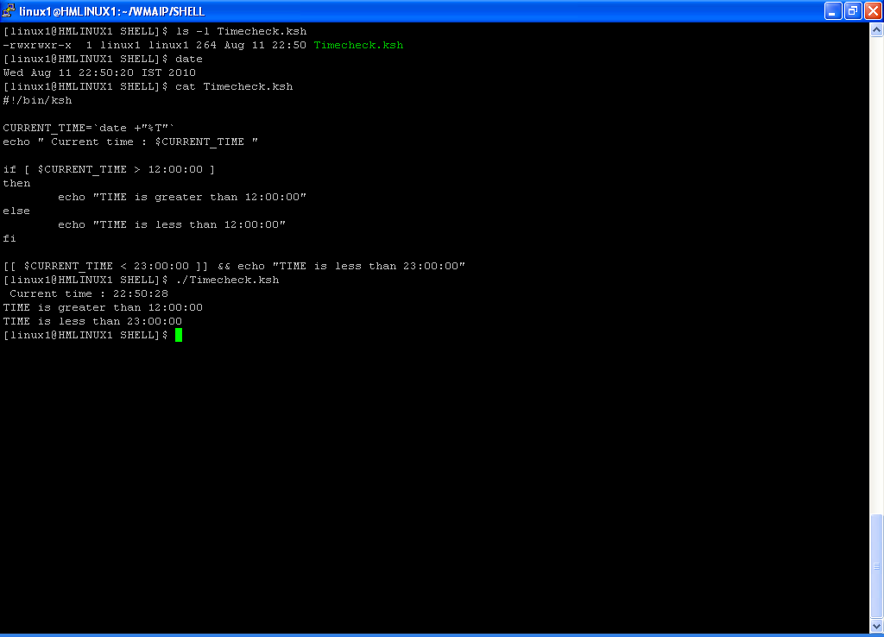
time comparision

Slide 32
else if = elif : Example
#!/bin/ksh
echo "1 - Start the App"
echo "2 - Shutdown the App"
echo "3 - Bounce the App"
echo "0 - Exit"
echo "Enter the choice [0-3]"
read choice
if [ $choice -eq 1 ]
then
echo "Selected Option -- 1"
else
if [ "$choice" = "2" ]
then
echo "Selected Option -- 2"
else
if [[ $choice -eq 3 ]]
then
echo "Selected Option -- 3"
else
if [ $choice -eq 0 ]
then
echo "Exit -- Selcted choice 0 "
else
echo "Invalid Choice"
fi
fi
fi
fi
#!/bin/ksh
echo "1 - Start the App"
echo "2 - Shutdown the App"
echo "3 - Bounce the App"
echo "0 - Exit"
echo "Enter the choice [0-3]"
read choice
if [ $choice -eq 1 ]
then
echo "Selected Option -- 1"
elif [ "$choice" = "2" ]
then
echo "Selected Option -- 2"
elif [[ $choice -eq 3 ]]
then
echo "Selected Option -- 3"
elif [ $choice -eq 0 ]
then
echo "Exit -- Selcted choice 0 "
else
echo "Invalid Choice"
fi

Slide 33
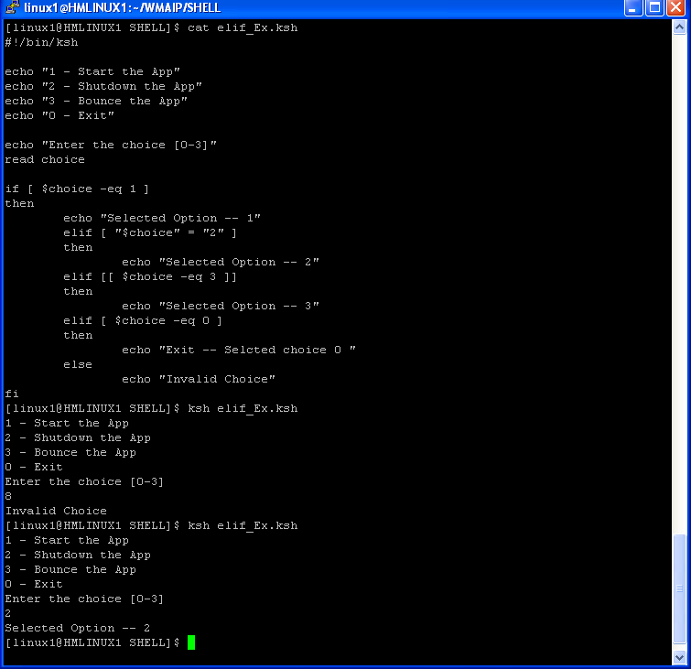
elif : Example

Slide 34
File test : Example
#!/bin/ksh
# /dev/sda2 is a block device.
device0="/dev/sda2"
if [ -b "$device0" ]
then
echo "$device0 is a block device."
fi
# /dev/ttyS1 is a character device.
device1="/dev/ttyS1"
if [ -c "$device1" ]
then
echo "$device1 is a character device."
fi
#!/bin/ksh
[[ -f /bin/ifconfig ]] && IP=/bin/ifconfig
if [ ! -s /bin/ifconfig ]
then
echo "ifconfig is not present in /bin or file size is 0 "
fi
[[ -f /sbin/ifconfig ]] && IP=/sbin/ifconfig
if [ ! -s /sbin/ifconfig ]
then
echo "ifconfig is not present in /sbin or file size is 0 "
exit
else
echo "ifconfig found in /sbin/"
fi
IP_ADDRESS=`$IP|grep -i "inet addr:"|cut -d ":" -f2|cut -d " " -f1 |grep -v "127.0.0.1"`
echo " IP Address = $IP_ADDRESS"

Slide 35
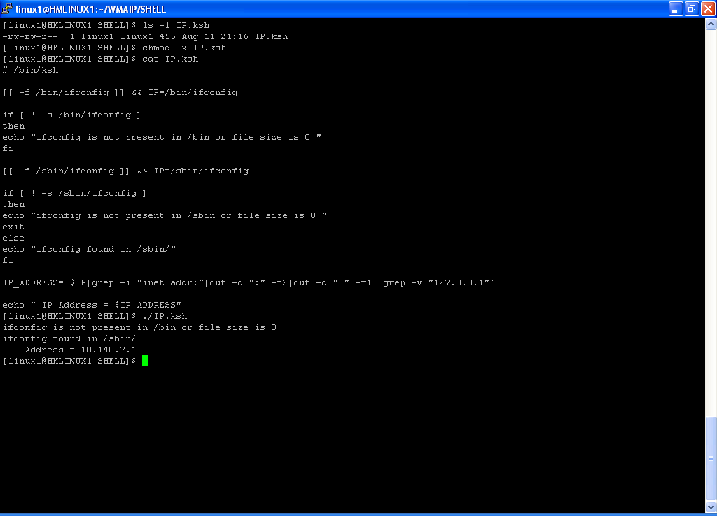
File Test: Example

Slide 36
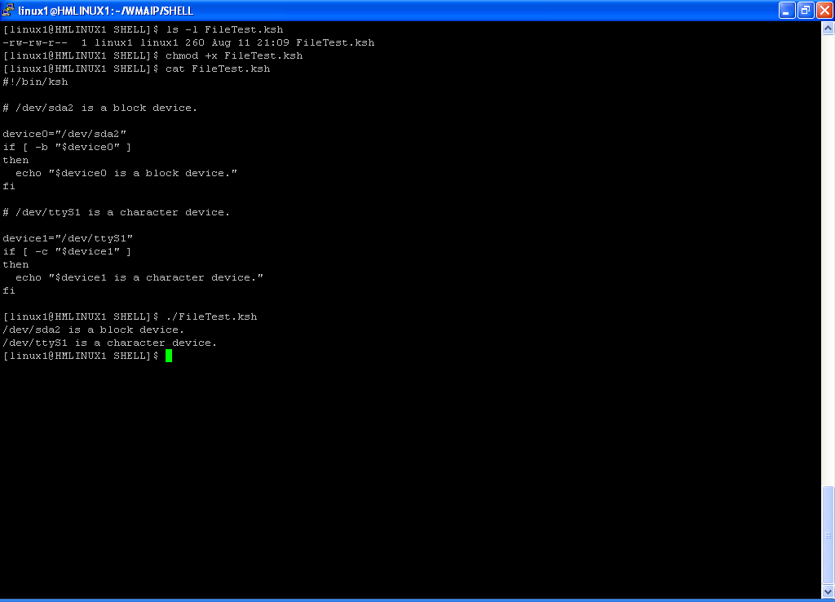
File test: Example

Slide 37
Example : String test
#!/bin/ksh
# $string1 has not been declared or initialized.
if [ -n $string1 ]
then
echo "String1 : is not null."
else
echo "String1 : is null."
fi
# Wrong result.
# Shows $string1 as not null, although it was not initialized.
echo
# This time, $string1 is enclosed in double quotes
if [ -n "$string1" ]
then
echo "String1 : is not null."
else
echo "String1 : is null."
fi
# Correct Result
echo
if [ $string1 ]
then
echo "String1 : is not null."
else
echo "String1 : is null."
fi
# Correct Result
#!/bin/ksh
echo "Enter 2 strings"
read str1 str2
if [ "$str1" = "$str2" ]
then
echo "Both the Strings are Equal"
else
echo "Strings are different"
fi
#!/bin/ksh
echo "OS : `uname`"
echo "Enter the value of str1="
read str1
if [ -z $str1 ]
then
echo "String Size is 0"
else
echo "String Size is Nonzero"
fi

Slide 38
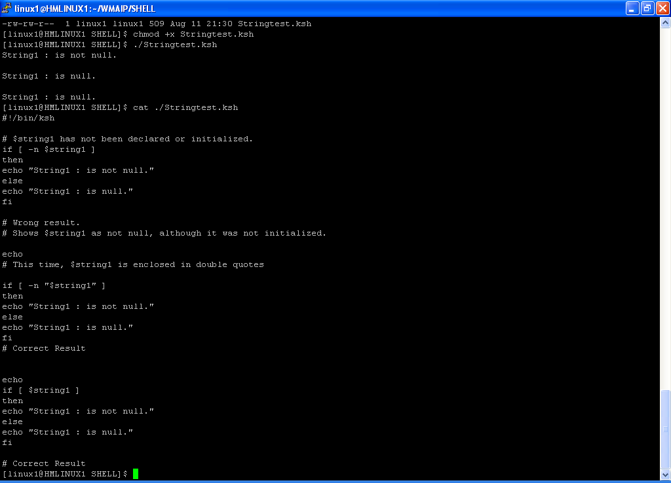
Example : String test

Slide 39
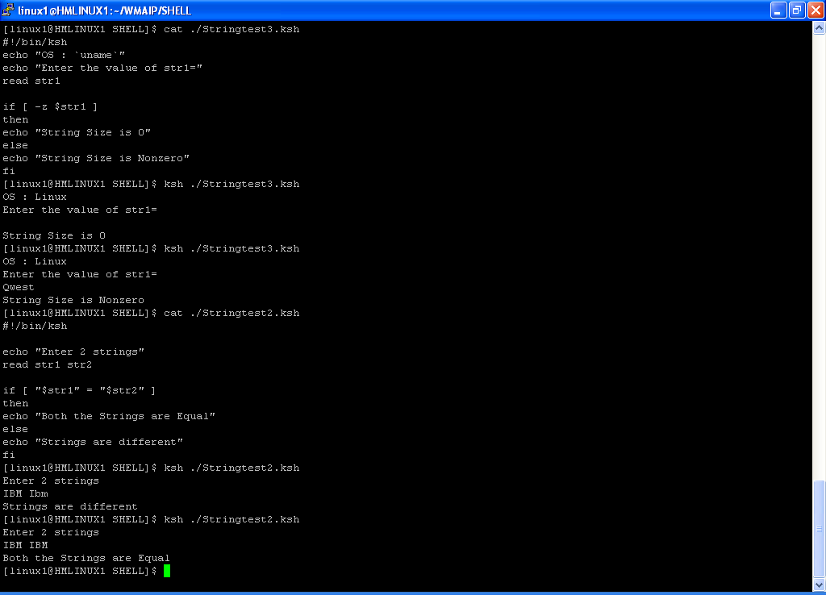
Example : String test

Slide 40
Flow control - case
case $val in
Choice1)
Statements ………
;;
Choice2)
Statements ………
;;
[1-9][0-9])
Statements ……… // Match only 2 digit numbers
;;
[a-z] | [A-Z] )
Statements ……… // Match only a single alphabet character
;;
Choice3|Choice4)
Statements ………
;;
*)
Statements [ This is default choice ]
;;
esac

Slide 41
case : Example
#!/bin/ksh
echo "Enter a Number Between [ 1-4 ]"
read NUM
case $NUM in
1)
echo "ONE"
;;
2)
echo "TWO"
;;
3)
echo "THREE"
;;
4)
echo "FOUR"
;;
*)
echo "$NUM is not [ 1 - 4 ]"
exit 1
;;
esac
#!/usr/bin/ksh
if [ $# -ne 1 ]
then
echo "Invalid Arguments::"
echo "Usage:: ./$0 [suomp19j/suomp20j/suomp21j/ALL]"
exit
fi
clear
server=`echo "$1" |tr '[:lower:]' '[:upper:]'`
mqstatus()
{
echo ""
printf "%55s\n" "MQSTATUS:$server"
echo "----------------------------------------------------------------------------------------------"
ssh -q bplapp@$server "cd /export/home/bplapp/BPL_SCRIPTS/MQ;./AllQueueDepth"
}
case $server in
'SUOMP19J'|'SUOMP20J'|'SUOMP21J')
mqstatus
;;
'ALL')
for server in suomp19j suomp20j suomp21j
do
mqstatus
done
;;
*)
echo "Invalid Arguments::"
echo "Usage:: ./$0 [suomp19j/suomp20j/suomp21j/ALL]"
;;
esac

Slide 42
case : Example
#!/usr/bin/ksh
# Source the Stop functions which is defined in /opt/proj/Setfunction.ksh #
. /opt/proj/Setfunction.ksh
if [ $# -ne 0 ]
then
echo "Invalid Arguments : "
echo "USAGE: $0"
exit
fi
clear
printf "%-30s \n" "BPL Process Control "
echo "--------------------------------------------------------------"
echo "1) Complete Stop BPL"
echo "0) exit"
echo "--------------------------------------------------------------"
echo "Enter Option :\c"
read opt
case $opt in
1)
Stop_GUI8001
Stop_XML8091
Stop_XML8081
Stop_XML8071
Stop_gateway
;;
0)
exit
;;
*)
echo "Invalid Option : Valid options are 0-1"
exit
;;
esac
#!/bin/ksh
if [ $# -ne 0 ]
then
echo "Usage : $0"
exit
fi
echo "Enter a Number"
read Num
case $Num in
[0-9])
echo "$Num :is a One digit Number "
;;
[0-9][0-9])
echo "$Num :is a two digit Number "
;;
[0-9][0-9][0-9])
echo "$Num :is a three digit Number "
;;
*)
echo "$Num :is greater than 999 or Entered value is not a number "
;;
esac

Slide 43
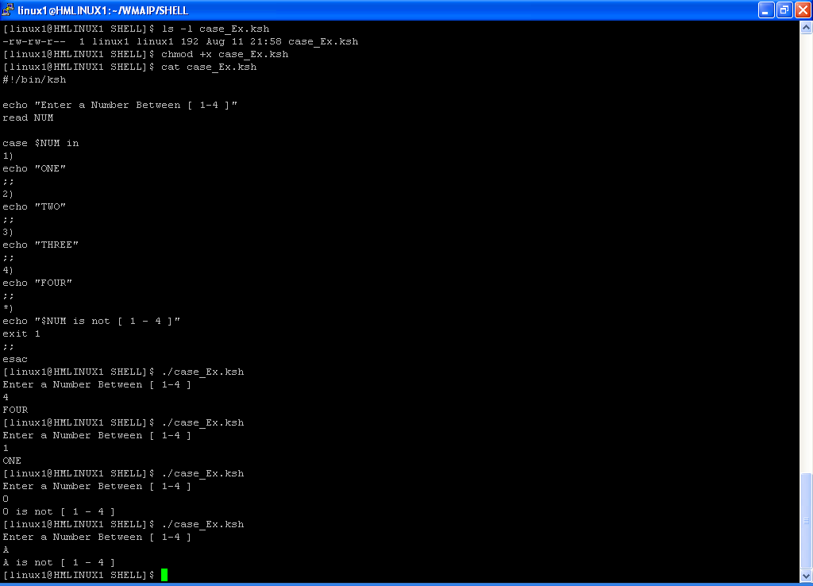
case : Example

Slide 44
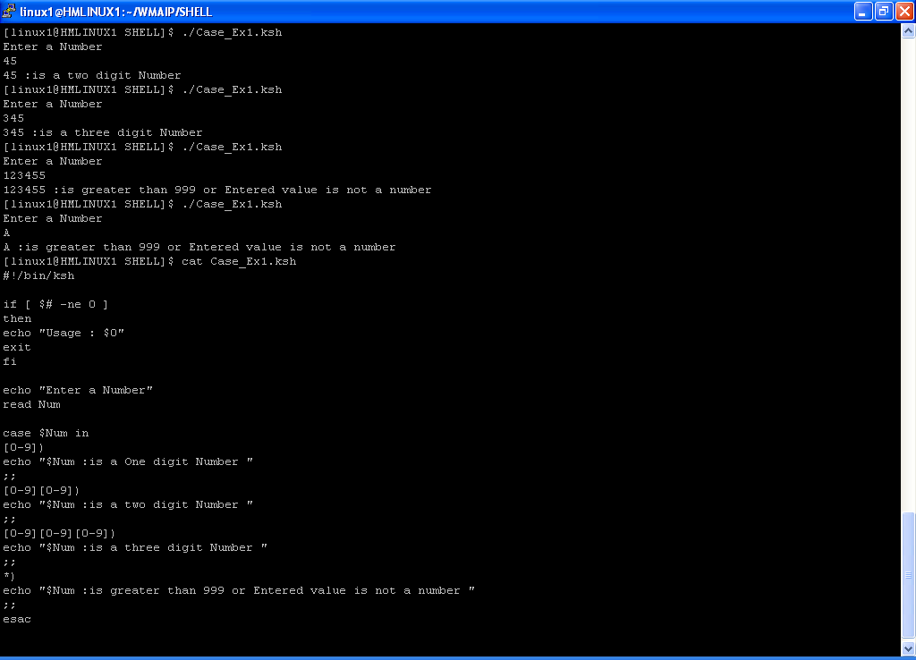
case : Example

Slide 45
Special Shell variables
Variable | Meaning
$0 | Name of script
$1 | Positional parameter #1
$2 − $9 | Positional parameters #2 − #9
${10} | Positional parameter #10
$# | Number of positional parameters
"$*" | All the positional parameters (as a single word)*
"$@" | All the positional parameters (as separate strings)
${#*} | Number of command line parameters passed to script
${#@} | Number of command line parameters passed to script
$? | Return value
$$ | Process ID (PID) of script
$− | Flags passed to script (using set)
$_ | Last argument of previous command
$! | Process ID (PID) of last job run in background

Slide 46
Special Shell variables
#!/bin/ksh
# USAGE : $0 1 2 3 4 5 6 7 8 9 10
if [ $# -lt 10 ]
then
echo "This script needs at least 10 command line arguments!"
exit
fi
echo
echo "The name of this script is : $0 "
echo "The name of this script is :`basename $0`"
echo "Number of Positional Parameter : $#"
if [ -n "$1" ]
then
echo "Parameter #1 is $1"
fi
if [ -n "$2" ]
then
echo "Parameter #2 is $2"
fi
if [ -n "$3" ]
then
echo "Parameter #3 is $3"
fi
if [ -n "${10}" ]
then
echo "Parameter #10 is ${10}"
fi
echo "All the commandline parameters are: "$*""
echo
echo "All the commandline parameters are: $@ “

Slide 47
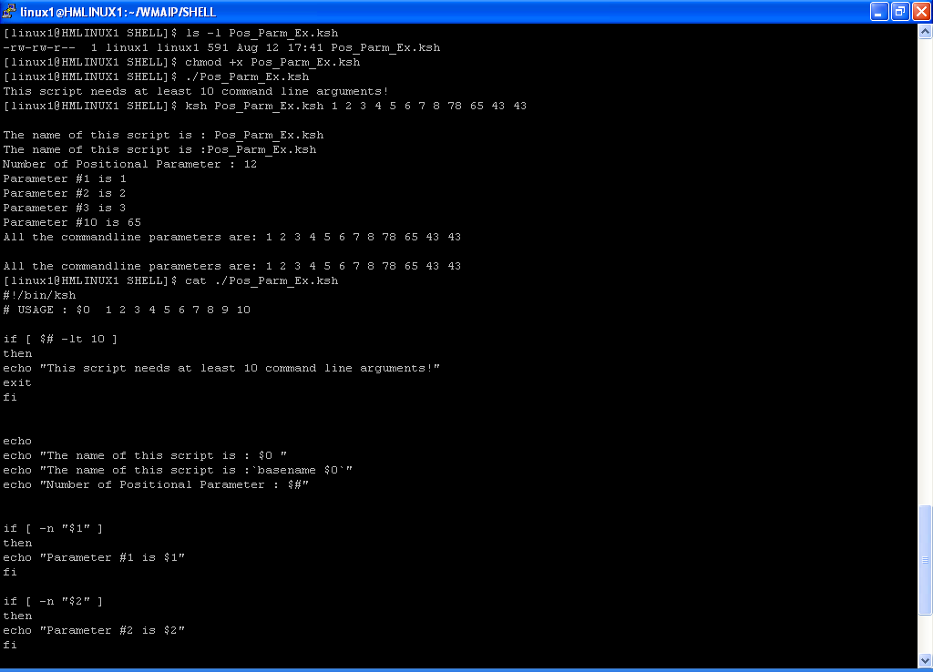
Special Shell variables

Slide 48
Positinal Parameter and use of shift
The command-line arguments $1, $2, $3,...$9 are positional parameters , with $0 pointing to the actual command, program, shell script, or function and $1, $2,$3, ...$9 as the arguments to the command.
The positional parameters, $0, $2, etc., in a function, are for the function’s use and may not be in the environment of the shell script that is calling the function. Where a variable is known in a function or shell script is called the scope of the variable.
The shift command is used to move positional parameters to the left; for example, shift causes $2 to become $1. We can also add a number to the shift command to move the positions more than one position; for example, shift 3 causes $4 to move to the $1position.Sometimes we encounter situations where we have an unknown or varying number of arguments passed to a shell script or function, $1, $2, $3... (also known as positional parameters). Using the shift command is a good way of processing each positional parameter in the order they are listed.

Slide 49
Positional Parameter Example:
#!/bin/ksh
echo “Number of Positinal parameters = $#”
echo “Script name = $0”
echo “Value of Parm 1 = $1”
echo “Value of Parm 10 = $10”
echo “Value of Parm 10 = ${10}”
echo “value of \$@ = $@”
echo “value of \$* = $*”
i=1
while [ $i –le $# ]
do
echo “$1”
Shift
i=$(( $i + 1 ))
done
#!/bin/ksh
echo "Number of Positinal parameters = $#"
echo "Script name = $0"
echo "Value of Parm 1 = $1"
echo "Value of Parm 10 = $10"
echo "Value of Parm 10 = ${10}"
echo "value of \$@ = $@"
echo "value of \$* = $*"
i=1
ARGC=$#
while [ $i -le $ARGC ]
do
echo "$1"
shift 1
i=$(( $i + 1 ))
done

Slide 50
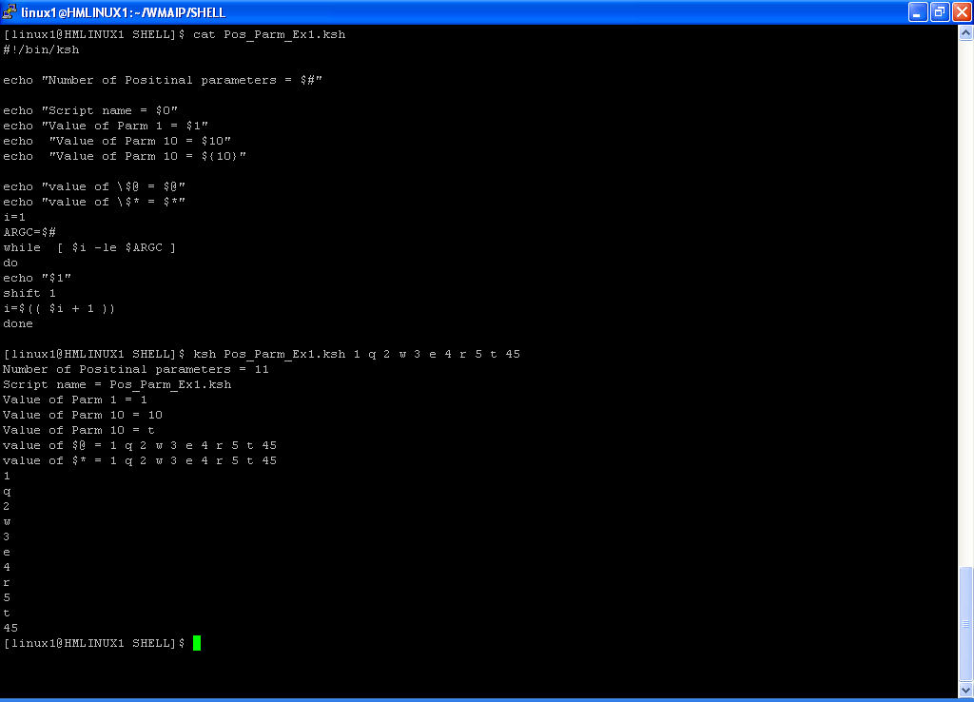
Positional Parameter Example:

Slide 51
Special Parameter Definitions
The $* special parameter specifies all command-line arguments.
The $@ special parameter also specifies all command-line arguments.
The “$*” special parameter takes the entire list as one argument with spaces between.
The “$@” special parameter takes the entire list and separates it into separate arguments.

Slide 52
Special parameter Example
#!/bin/ksh
for val in $*
do
echo "$val"
done
for val in $@
do
echo "$val"
done
for val in "$*"
do
echo "$val"
done
for val in "$@"
do
echo "$val"
done

Slide 53
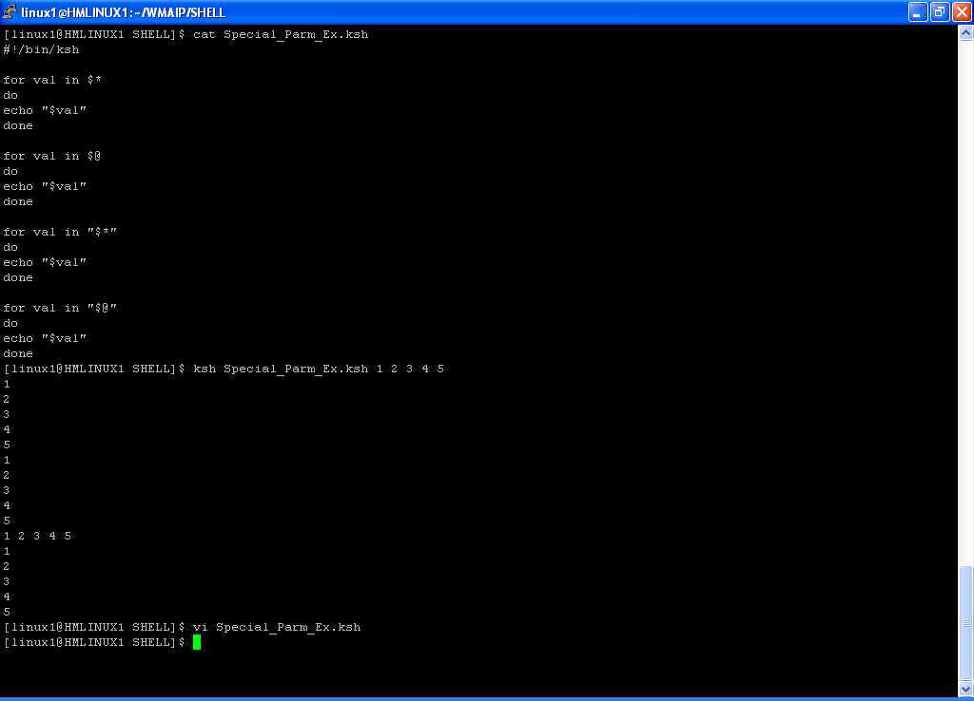
Special parameter Example

Slide 54
set
$set `date`
$echo $1
Tue
$echo $2
Sep
$echo $3
7
$echo $4
14:21:53
$echo $*
Tue Sep 7 14:21:53 IST 2010
$echo $@
Tue Sep 7 14:21:53 IST 2010

Slide 55
while loop
while [ condition ]
do
Statements …
done
cat Filename| while read Variable..
do
Statements …
done
while read Variable(S)
do
Statements …
done <filename
while [ : ]
do
….stmt…
done
command| while read Variable..
do
Statements …
done
One liner
while [ cond ]; do stmt; stmt1; done
Skip lines while reading contents from the previous command
command | while read var
do
read var1
echo $var
done

Slide 56
while loop - Example
#!/bin/ksh
if [ $# -ne 0 ]
then
echo “USAGE: $0”
exit
fi
echo “Enter a Number :“
read num
i=0
while [ $i –le $num ]
do
echo $i
i=$(( $i + 1 ))
done
#!/bin/ksh
if [ $# -ne 0 ]
then
echo “USAGE: $0”
exit
fi
echo “List of Users present in /etc/passwd File :”
cat /etc/passwd |while read rec
do
User=`echo $rec|cut –d “:” –f1`
echo $User
done

Slide 57
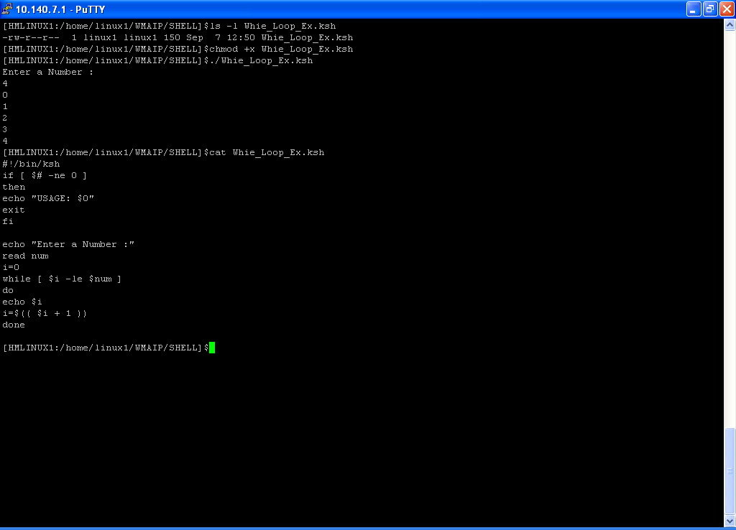
while loop - Example

Slide 58
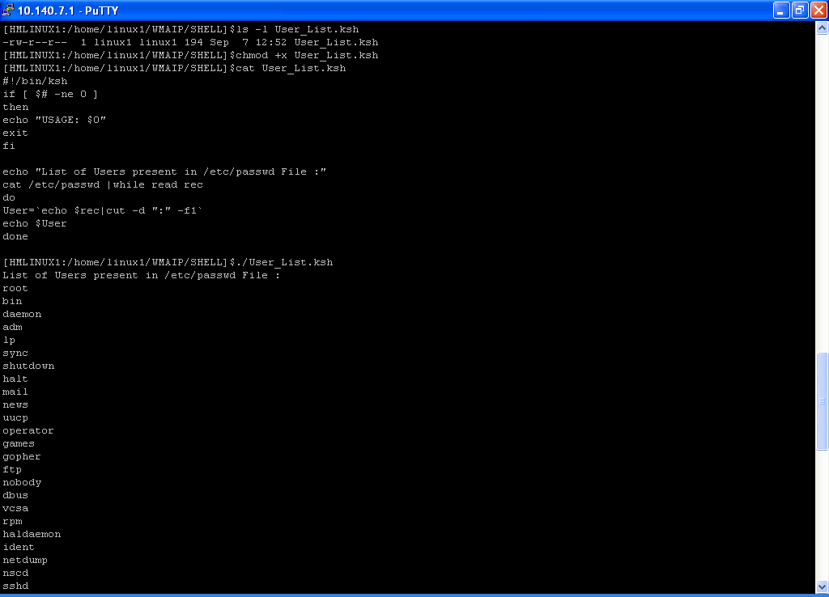
while loop - Example

Slide 59
while loop - Example
#!/bin/ksh
if [ $# -ne 0 ]
then
echo “USAGE: $0”
exit
fi
echo “List of Users present in /etc/passwd File :”
cat /etc/passwd |while read rec
do
User=`echo $rec|cut –d “:” –f1`
if [ “$User” = “user9” ]
then
break
fi
echo $User
done
#!/bin/ksh
if [ $# -ne 0 ]
then
echo “USAGE: $0”
exit
fi
echo “Password file entry for root :”
cat /etc/passwd |while read rec
do
User=`echo $rec|cut –d “:” –f1`
if [ “$User” != “root” ]
then
continue
fi
echo $rec
done
echo “---Password file entry for root---”
getent passwd root

Slide 60
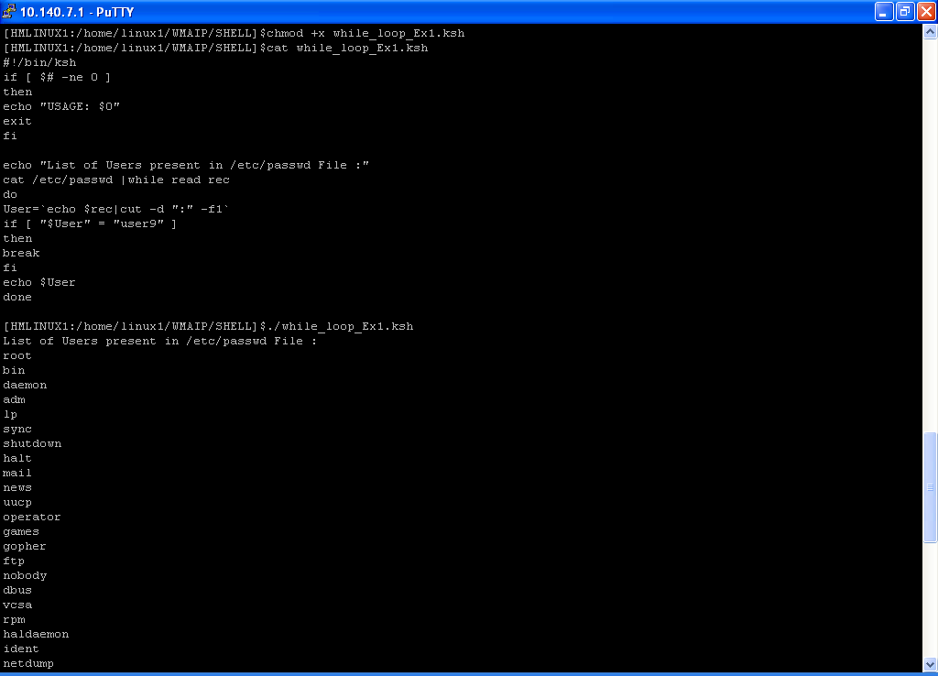
while loop - Example

Slide 61
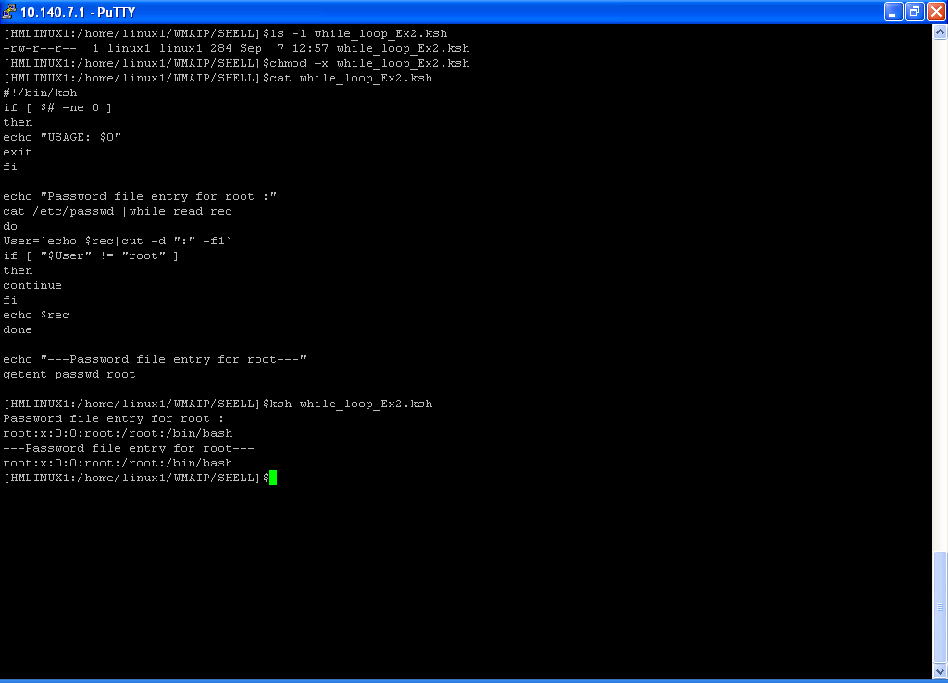
while loop - Example

Slide 62
while loop - Example
#!/bin/ksh
if [ $# -ne 0 ]
then
echo “USAGE: $0”
exit
fi
echo “List of Users present in /etc/passwd File :”
while read rec
do
User=`echo $rec|cut –d “:” –f1`
if [ “$User” = “user9” ]
then
break
fi
echo $User
done< /etc/passwd
#!/bin/ksh
if [ $# -ne 0 ]
then
echo “USAGE: $0”
exit
fi
cat config_file|grep –v “^#” |while read rec
do
echo $rec
done

Slide 63
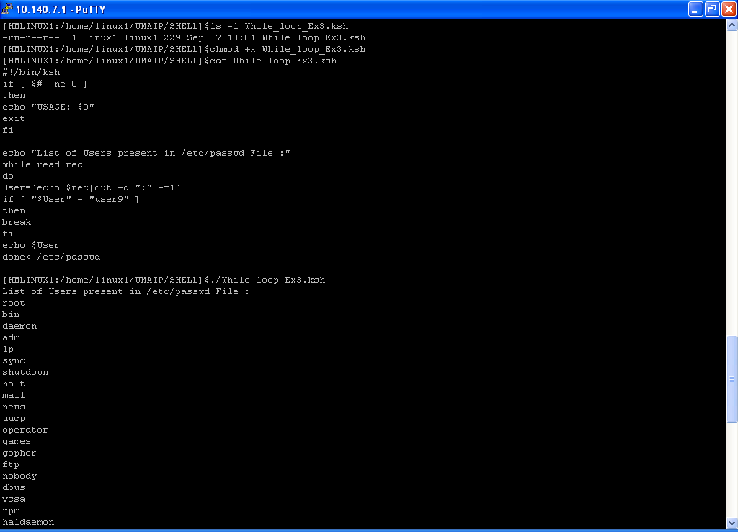
while loop - Example

Slide 64
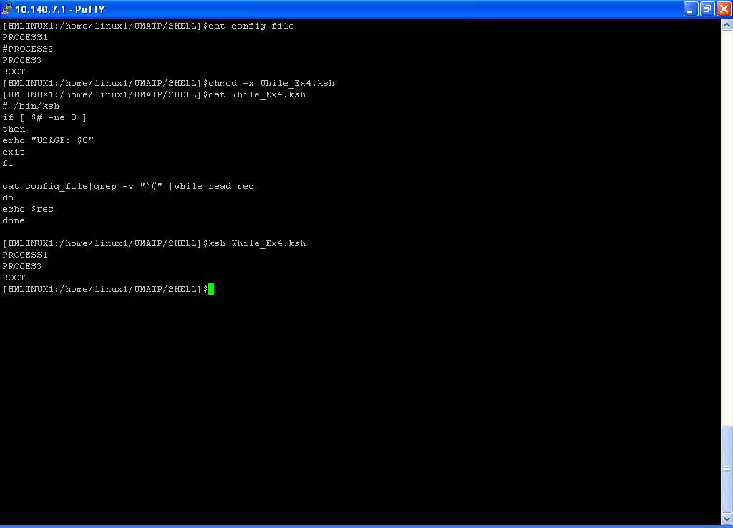
while loop - Example

Slide 65
while loop - Example
#!/bin/ksh
echo “Odd Numbers from 1-50 :”
seq 50 |while read num
do
echo $num
read num1
done
#!/bin/ksh
echo “Series : 1 5 9 …( Range 1-50)”
seq 50 |while read num
do
echo $num
read num1
read num2
read num3
done
#!/bin/ksh
echo “Even Numbers from 1-50 :”
seq 50 |while read num
do
read num1
echo $num1
done
#!/bin/ksh
cat /etc/passwd |while read rec
do
echo $rec
read rec1
done

Slide 66
until loop
until [ condition ]
do
….Statements …
done
#!/bin/ksh
if [ $# -ne 0 ]
then
echo “USAGE: $0”
exit
fi
echo “Enter a Number :“
read num
i=0
until [ $i –gt $num ]
do
echo $i
i=$(( $i + 1 ))
done

Slide 67
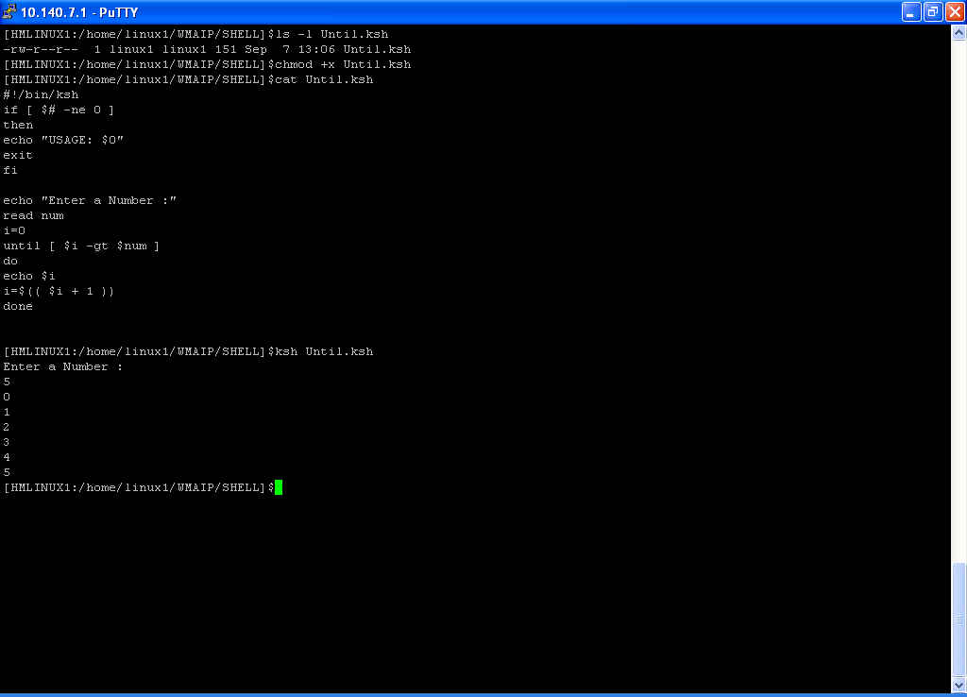
until loop - Example

Slide 68
for loop
for var in vaue(S)
do
… Statement …
done
for var in `seq 10`
do
….Statement …
done
for var in `command`
do
….Statement …
done
C-type for loop
for (( var=0;var<=10;var++ ))
do
….Statement …
done

Slide 69
For loop - Example
#!/usr/bin/ksh
if [ $# -ne 1 ]
then
echo "Invalid Arguments::"
echo "Usage:: ./$0 [suomp19j/suomp20j/suomp21j/ALL]"
exit
fi
clear
server=`echo "$1" |tr '[:lower:]' '[:upper:]'`
case $server in
'SUOMP19J')
ssh -q bplapp@$server "cd /export/home/bplapp/BPL_SCRIPTS;./monitor_bpl"
;;
'SUOMP20J')
ssh -q bplapp@$server "cd /export/home/bplapp/BPL_SCRIPTS;./monitor_bpl"
;;
'SUOMP21J')
ssh -q bplapp@$server "cd /export/home/bplapp/BPL_SCRIPTS;./monitor_bpl"
;;
'ALL')
for servername in suomp19j suomp20j suomp21j
do
ssh -q bplapp@$servername "cd /export/home/bplapp/BPL_SCRIPTS;./monitor_bpl"
done
;;
*)
echo "Invalid Arguments::"
echo "Usage:: ./$0 [suomp19j/suomp20j/suomp21j/ALL]"
;;
esac

Slide 70
select loop -- observe and see How it works ☺
#!/bin/bash
echo "***********************"
select opt in Start Stop Bounce
do
case $opt in
Start)
echo "Selected Option - Start"
;;
Stop)
echo "Selected Option - Stop"
;;
Bounce)
echo "Selected Option - Bounce"
;;
*)
echo "Invalid Choice .. $opt"
exit 1
esac
echo "***********************"
# Comment the Break ,If you want to come back
# to main menu untill the slected option is exit
break
done
#!/bin/bash
echo "***********************"
select opt in Start Stop Bounce Exit
do
case $opt in
Start)
echo "Selected Option - Start"
;;
Stop)
echo "Selected Option - Stop"
;;
Bounce)
echo "Selected Option - Bounce"
;;
Exit)
exit
;;
*)
echo "Invalid Choice .. $opt"
exit 1
;;
esac
echo "***********************"
done

Slide 71
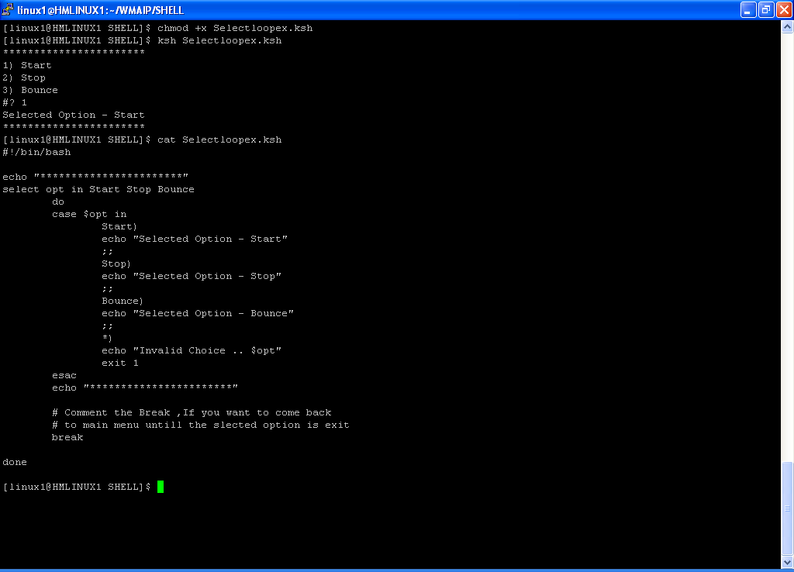
select loop Example

Slide 72
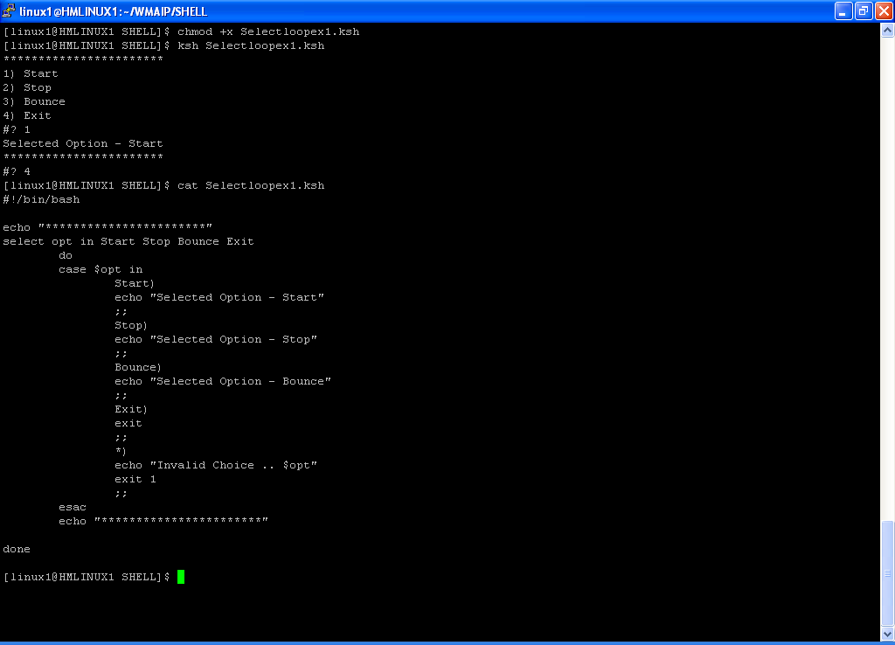
select loop Example

Slide 73
function
Functions are blocks of script code that you assign a name to, then reuse anywhere in your code .
Anytime you need to use that block of code in your script, all you need to do is use the function name you assigned it (referred to as calling the function).
There are two formats you can use to create functions in bash shell scripts.
function name {
commands
}
name() {
commands
}

Slide 74
Function - Example
#!/bin/ksh
sum()
{
Sum=$(( $1 + $2 ))
echo “SUM OF $1 , $2 is $Sum”
}
## Main Script ##
echo “Enter 2 Numbers”
read num1 num2
sum $num1 $num2
sum $1 $2
sum $1 10
sum $2 20
sum 20 10
Note : Run the Script like :
Script_name 45 55
And observe the output
#!/bin/ksh
Menu()
{
clear
echo “----App Control ----”
echo “1 – Stop”
echo “2 – Start”
echo “0 – Exit”
echo “Enter the option :”
read option
}
start()
{
echo “Starting the application”
}
shutdown()
{
echo “Shutting down the application”
}
## Main Script ##
Menu
case $option in
0)
exit ;;
1)
shutdown ;;
2)
start ;;
*)echo “Invalid Choice : $option “
;;
esac

Slide 75
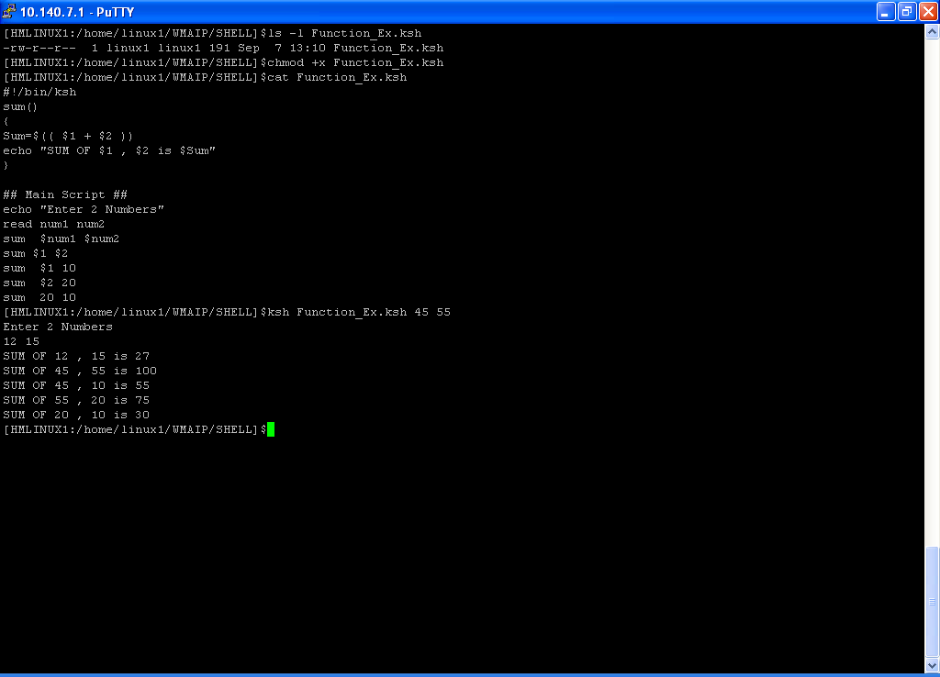
Function - Example

Slide 76
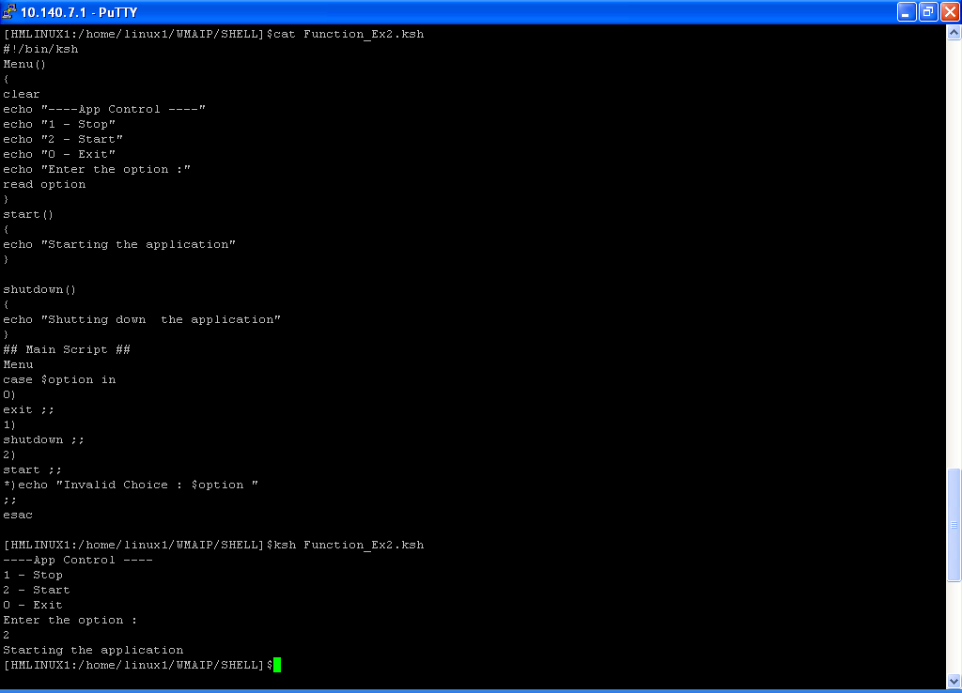
Function - Example

Slide 77
getopts , optargs
Getopts : Retrieve the options and values specified on the shell command line.
$ cat getopts_ex
#!/bin/bash
# simple demonstration of the getopts command
while getopts :ab:c opt
do
case "$opt" in
a) echo "Found the -a option" ;;
b) echo "Found the -b option, with value $OPTARG";;
c) echo "Found the -c option" ;;
*) echo "Unknown option: $opt";;
esac
done

Slide 78
getopts , optargs
$ ./getopts_ex -ab test1 -c
Found the -a option
Found the -b option, with value test1
Found the -c option
$ ./getopts_ex -b "test1 test2" -a
Found the -b option, with value test1 test2
Found the -a option
$ ./getopts_ex -abtest1
Found the -a option
Found the -b option, with value test1
$ ./getopts_ex -d
Unknown option: ?
$ ./getopts_ex -acde
Found the -a option
Found the -c option
Unknown option: ?
Unknown option: ?
Note : Refer Linux Command line and Shell scripting Book for more details

Slide 79
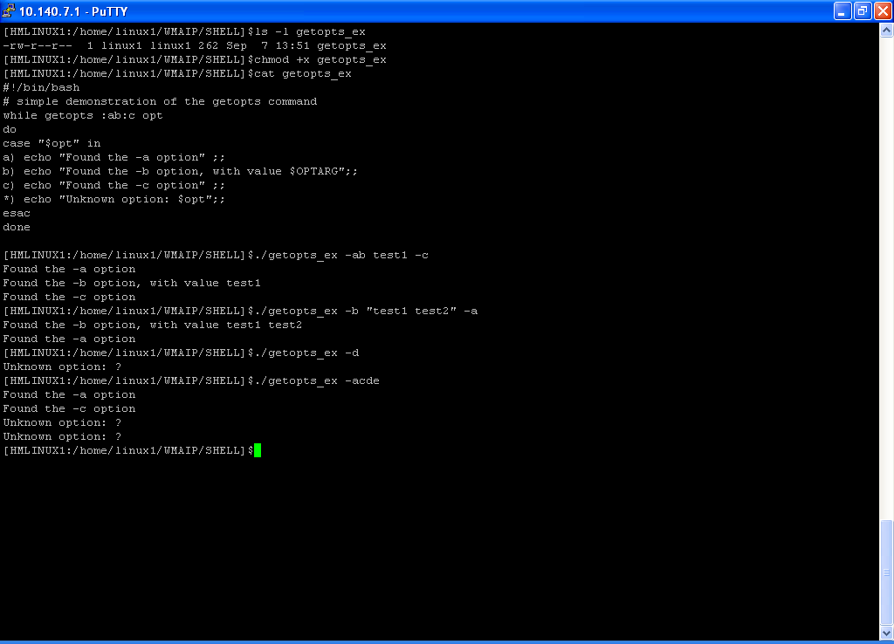
Getopts - Example

Slide 80
wait & sleep
wait:
Stop script execution until all jobs running in background have terminated, or until the job number orprocess ID specified as an option terminates.
sleep :
It pauses for a specified number of seconds, doing nothing.It can be useful for timing

Slide 81
wait & sleep - Example
### Wait_Ex1.ksh ###
#!/bin/ksh
echo "Inside ... $0"
sleep 15
echo "Done -- $0“
### Wait_Ex.ksh ###
#!/bin/ksh
echo "$0 - Started "
echo "Execute Wait1 .."
ksh Wait_Ex1.ksh &
wait $!
echo "$0 -- Done"
### Wait_Ex1.ksh ###
#!/bin/ksh
echo "Inside ... $0"
sleep 15
echo "Done -- $0“
### Wait_Ex.ksh ###
#!/bin/ksh
echo "$0 - Started "
echo "Execute Wait1 .."
ksh Wait_Ex1.ksh &
#wait $!
sleep 5
echo "$0 -- Done"

Slide 82
trap
The trap command allows to specify which signals your shell script can watch for and intercept from the shell.
If the script receives a signal listed in the trap command, it prevents it from being processed by the shell, and instead handles it locally.
#!/bin/bash
echo “SCRIPT STARTED"
#trap "echo Don’t Press CTRL+C" SIGINT SIGTERM
trap "echo Don’t Press CTRL+C" 2 15
i=1
while [ $i -le 10 ]
do
echo “Loop Iteration: $i"
sleep 10
#i=$[ $i + 1 ]
i=$(( $i + 1 ))
done
echo “END OF SCRIPT"

Slide 83
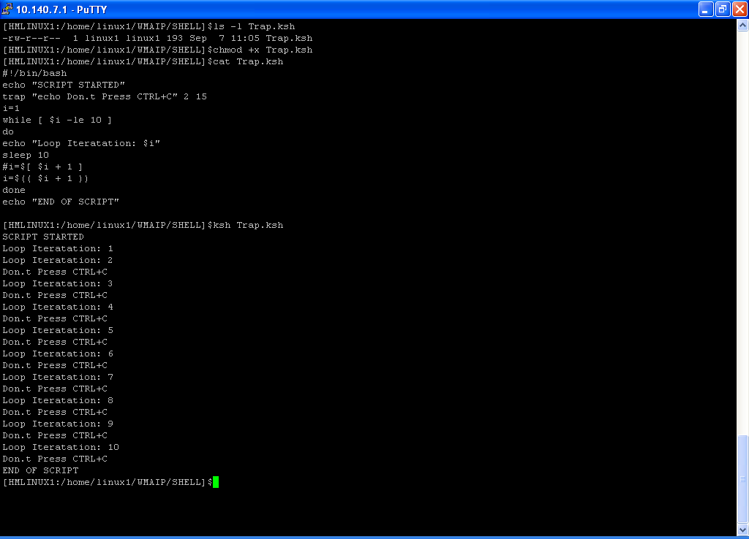
Trap -Example

Slide 84
return
The return command allows you to specify a single integer value to define the function exit status.
Remember to retrieve the return value as soon as the function completes.
Remember that an exit status can only be in the range of 0 to 255.
If you execute any other commands before retrieving the value of the function using the $? variable,the return value from the function will be lost (remember, the $? variable returns the exit status of the last executed command).
The second problem defines a limitation for using this return value technique. Since an exit statusmust be less than 256, the result of your function must produce an integer value less than 256.
Any values over that returns an error value.
You can’t use this return value technique if you need to return either larger integer values or a string value.

Slide 85
Return - Example
#!/bin/ksh
Check_HawkAgent()
{
P_CNT=`ps -fu username|grep -i "hawkagent"|grep -v grep|wc -l`
return $P_CNT
}
### Main Script ###
THRESHOLD=1
Check_HawkAgent
STATUS=$?
if [ $STATUS -eq 0 ]
then
P_STAT=`echo "\033[7m Not Running \033[m"`
elif [ $STATUS -ne $THRESHOLD ]
then
P_STAT=`echo "\033[7m Process Count Did Not Match \033[m"`
else
P_STAT="Running"
fi
printf "%-35s %-25s \n" “HAWK PROCESS” “$P_STAT”

Slide 86
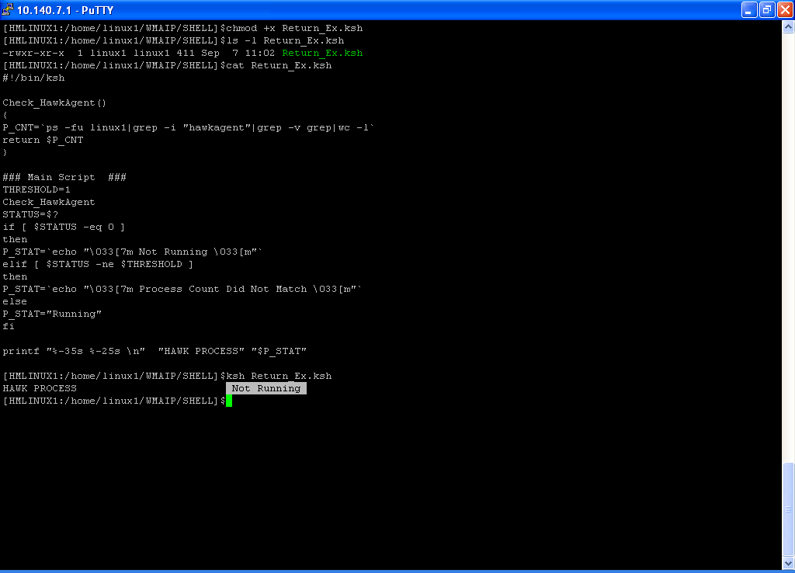
Return Example

Slide 87
eval
Assume that the value of a variable is the name of a second variable.
Is it somehow possible to retrieve the value of this second variable from the first one ?
For example,
if a=letter_of_alphabet
and
letter_of_alphabet=z
can a reference to a return z ?
This can be done using eval .
This is called an indirect reference.
eval var1=\$$var2

Slide 88
eval - Example
#!/bin/ksh
Val=Var1
Var1=Qwest
echo
echo “Val = $Val"
eval Val=\$$Val
echo "New Val = $Val"

Slide 89
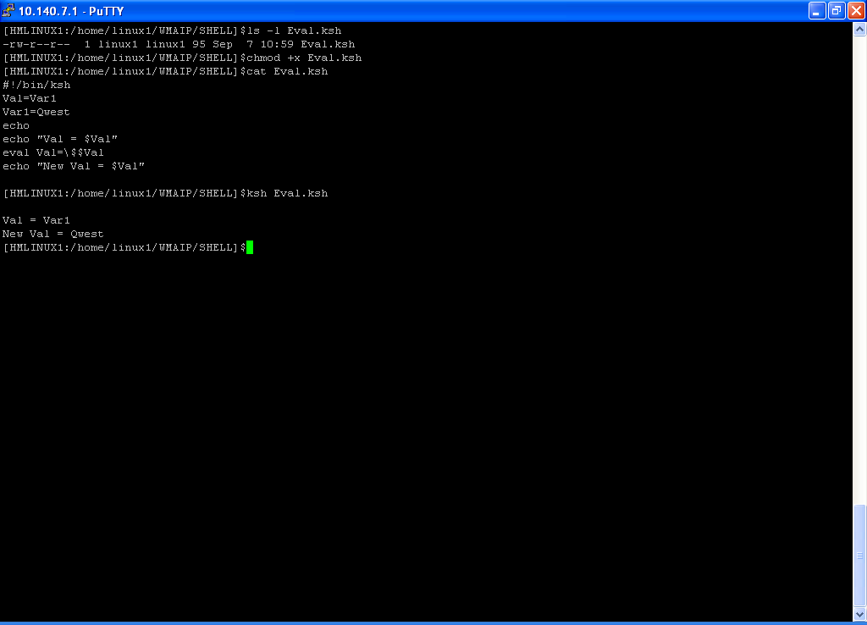
Eval - Example

Slide 90
File descriptors
The file descriptors for stdin, stdout, and stderr are 0, 1, and 2, respectively .
For opening additional files, there remain descriptors 3 to 9 .
It is sometimes useful to assign one of these additional file descriptors to stdin, stdout, or stderr as a temporary duplicate link.
For Details Please refer advance Bash shell scripting Book

Slide 91
File descriptors - Example
#!/bin/ksh
LOGFILE=logfile.txt
exec 6>&1 # Link file descriptor #6 with stdout.
# Saves stdout.
exec > $LOGFILE # stdout replaced with file "logfile.txt".
# −−−−−−−−−−−−−−−−−−−−−−−−−−−−−−−−−−−−−−−−−−−−−−−−−−−−−−−−−−− #
# All output from commands in this block sent to file $LOGFILE.
echo −n "Logfile: "
date
echo "−−−−−−−−−−−−−−−−−−−−−−−−−−−−−−−−−−−−−"
echo
echo "Output of \"ls −al\" command"
echo
ls −al
echo; echo
echo "Output of \"df\" command"
echo
df
# −−−−−−−−−−−−−−−−−−−−−−−−−−−−−−−−−−−−−−−−−−−−−−−−−−−−−−−−−−− #
exec 1>&6 6>&− # Restore stdout and close file descriptor #6.

Slide 92
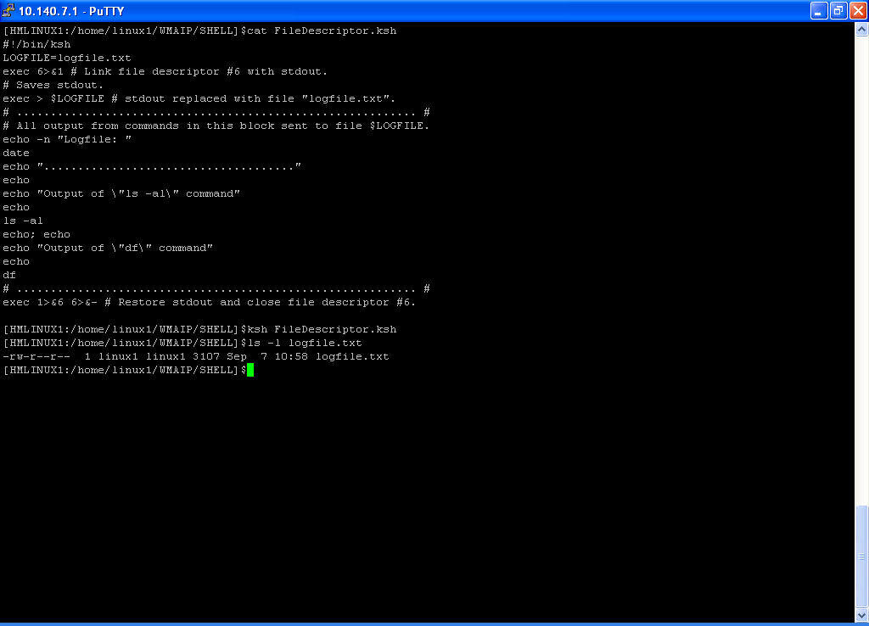
File descriptors - Example

Slide 93
Timing out
#!/bin/bash
# timing the data entry
if read -t 5 -p "Please enter your name: " name
then
echo "Hello $name, welcome to my script"
else
echo
echo "Sorry, too slow!"
fi

Slide 94
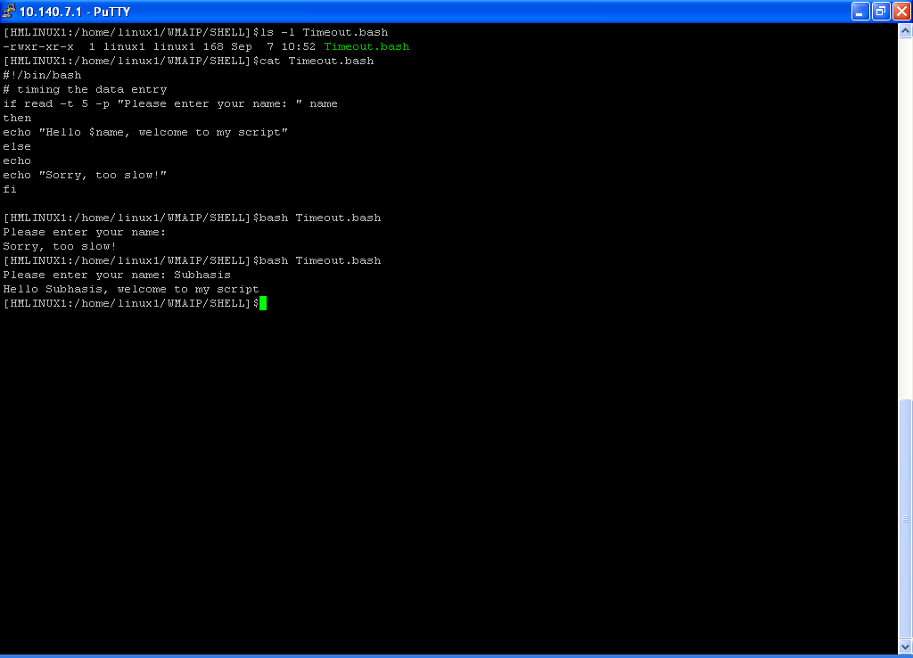
Timing out - Example

Slide 95
Execute the sql batch jobs using Shell Script.
#!/bin/ksh
DBNAME=SID
USERID=dbuser
PASSWORD=dbpwd
#Validate database ID & PASSWORD @SCHEMA
sqlplus -s /nolog <<EOF
whenever sqlerror exit failure
connect $USERID/$PASSWORD@$DBNAME
exit success
EOF
[ $? -ne 0 ] && { echo "Connection failed ."; exit 1; }
echo "Connection succeeded for user $USERID, SID $DBNAME"
sqlplus -s $USERID/$PASSWORD@$DBNAME @ ./order.sql >./Failed_orders.tmp

Slide 96
Debugging
To set the debug mode ,Execute :
set –vx
To off the debug mode ,Execute :
set +vx
Or you can exacute the script like :
ksh –x ScriptName.ksh
bash –x ScriptName.bash

Slide 97
Quoting Variables
When referencing a variable, it is generally advisable to enclose its name in double quotes. This prevents reinterpretation of all special characters within the quoted string.
#!/bin/ksh
Display()
{
echo $1
}
## MAIN SCRIPT ##
VAR="Use double quote while referencing a variable"
Display $VAR
Display "$VAR"

Slide 98
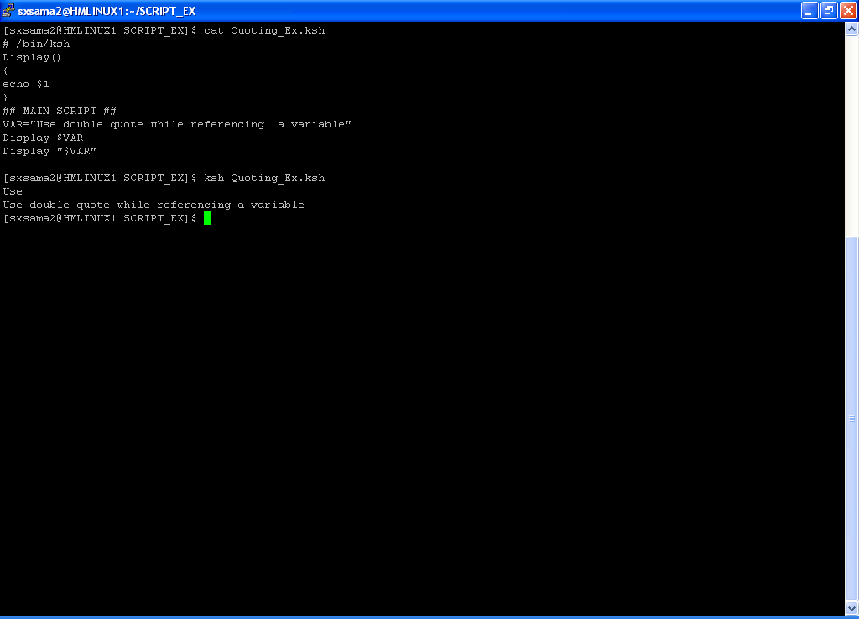
Quoting Variables - Example

Slide 99
$RANDOM - To generate random integer
$RANDOM returns a different random integer at each invocation.
Let if you want to shuffle a file content you can use $RANDOM
#!/bin/ksh
if [ ! -s "$1" ]
then
echo "File does not exist / Size is zero : $1"
exit
fi
TMP_FILE=/tmp/Shuf.out.tmp
>$TMP_FILE
cat "$1" |while read rec
do
echo $RANDOM:"$rec" >>$TMP_FILE
done
cat $TMP_FILE|sort -n |cut -d ":" -f2-
rm $TMP_FILE

Slide 100
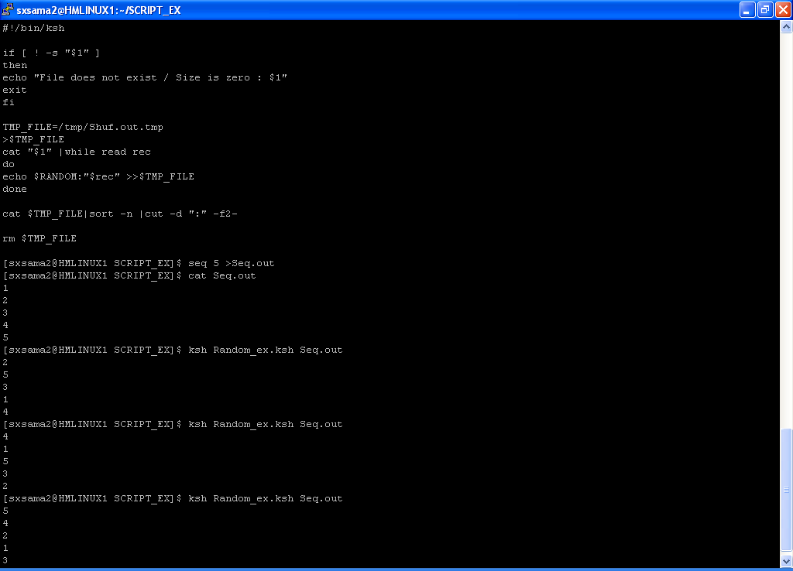
$RANDOM - To generate random integer - Example

Slide 101
Double Parentheses Construct
We can use this construct
To set a value in C style syntax
For Post−increment,Post−decrement ,Pre−increment and Pre−decrement
C−style trinary operator.
This syntax may not work in some of the KSH versions .
#!/bin/bash
echo
(( a = 23 )) ;echo "a (initial value) = $a"
(( a++ )) ;echo "a (after a++) = $a"
(( a-- )) ;echo "a (after a--) = $a"
(( ++a )) ;echo "a (after ++a) = $a"
(( --a )) ;echo "a (after --a) = $a"
(( t = a<45?7:11 )) ;echo $t
a=56
(( t = a<45?7:11 )) ;echo $t
echo
Refer Advance bash shell scripting guide to know more about :
The Double Parentheses Construct

Slide 102
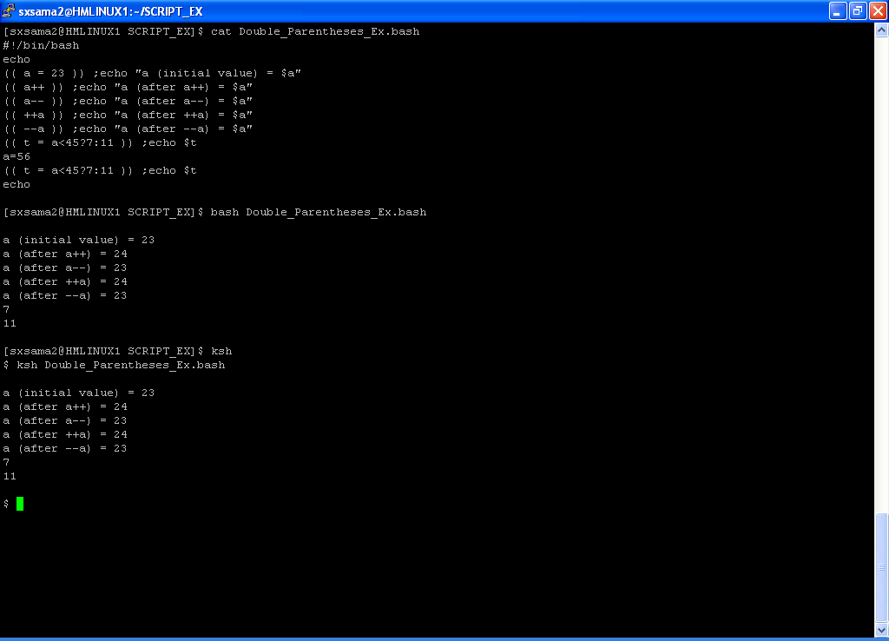
Example : Double Parentheses Construct

Slide 103
Substring Replacement
${string/substring/replacement}
Replace first match of $substring with $replacement.
${string//substring/replacement}
Replace all matches of $substring with $replacement.
${string/#substring/replacement}
If $substring matches front end of $string, substitute $replacement for $substring.
${string/%substring/replacement}
If $substring matches back end of $string, substitute $replacement for $substring.
For details refer advance bash Shell script guide

Slide 104
Substring Replacement
stringZ=abcABC123ABCabc
echo ${stringZ/abc/xyz} # xyzABC123ABCabc
# Replaces first match of 'abc' with 'xyz'.
echo ${stringZ//abc/xyz} # xyzABC123ABCxyz
# Replaces all matches of 'abc' with # 'xyz'.
echo ${stringZ/#abc/XYZ} # XYZABC123ABCabc
# Replaces front−end match of 'abc' with 'XYZ'.
echo ${stringZ/%abc/XYZ} # abcABC123ABCXYZ
# Replaces back−end match of 'abc' with 'XYZ'.

Slide 105
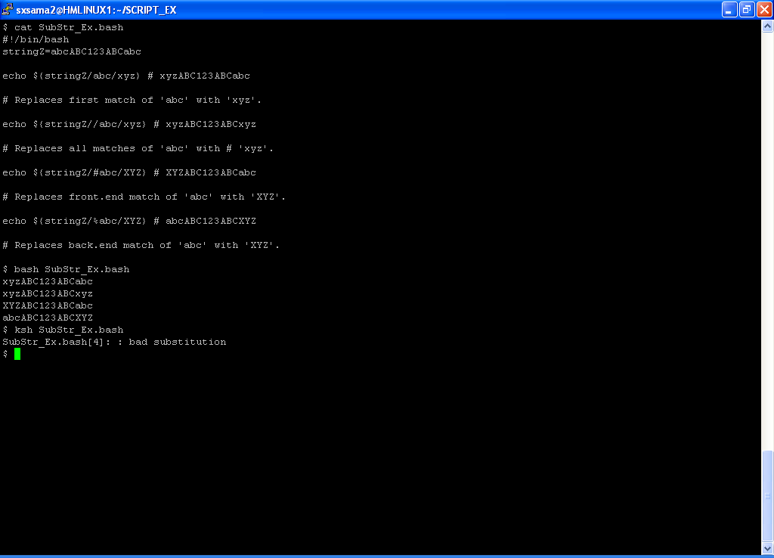
Example: Substring Replacement

Slide 106
Thank You !!!!
Any Questions Mail me ☺
Subhasis.samantaray@centurylink.com subhasis.samantaray@gmail.com

